Slide 1

future crime trends and police staffing requirements in York Region
Behnam Asadi
2023-11-20

Slide 2
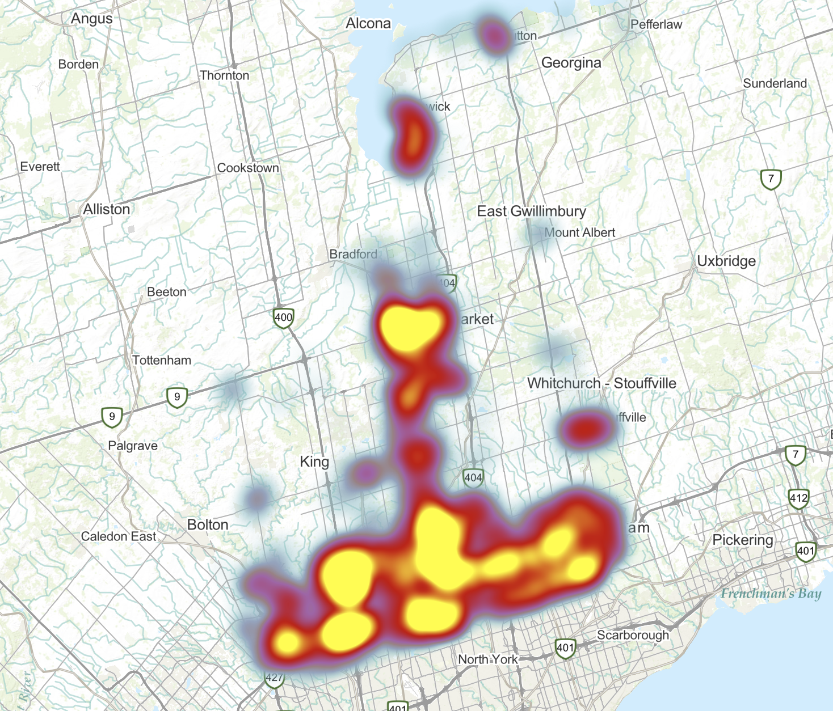
Outline
Introduction
Task 1
Task 2
Future Work

Slide 3
Introduction
Introduction
Key Goals
Analyze and Predict Crime Trends in York Region.
Optimize Law Enforcement Resource Allocation.
Methodological Approach
Combining Historical Crime Data with External Factors.
Utilizing Advanced Predictive Modeling.
Impact
Support Strategic Law Enforcement Planning and Decision-Making.
Contribute to a Safer, More Informed Community.

Slide 4
Overview
Task 1
Objective
Regression: Forecast the average future number of crimes in York Region.
Approach
Using multiple features (values we already know) to predict target (The value we want to know).
Emphasis on feature engineering to enhance model accuracy.
Significance
Aiding proactive crime management and prevention strategies.
Providing actionable insights for law enforcement agencies.

Slide 5
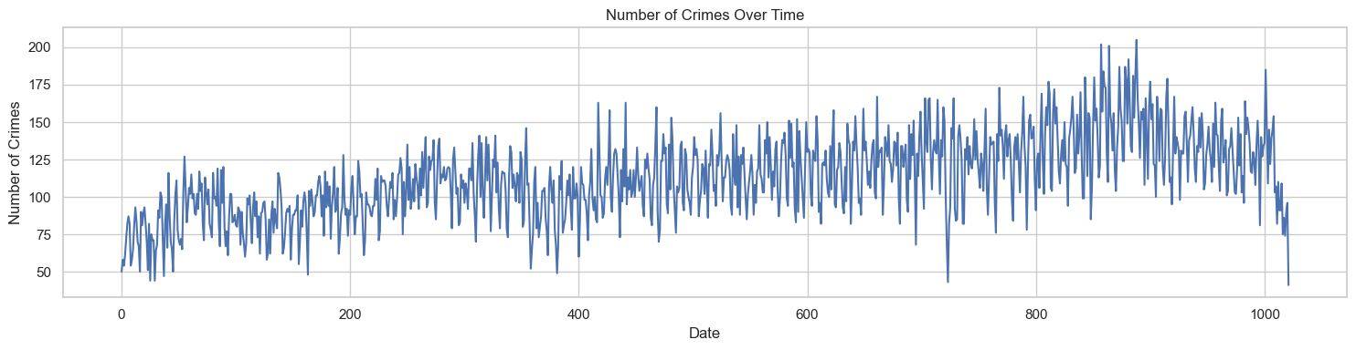
Crime Data
Task 1
Crimes committed after 2021
Volatile nature of the target (Number of Daily Crimes)
Smoothing target function by average each 30 days
Ignoring data for last two weeks

Slide 6
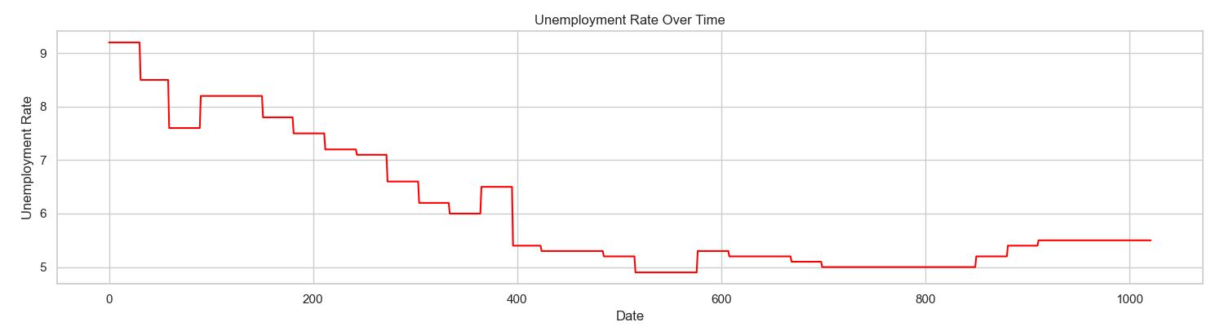
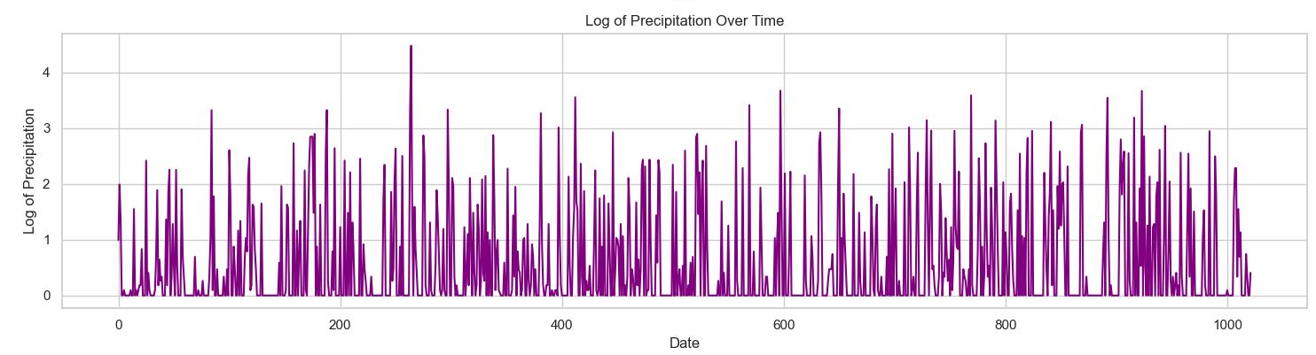
External Data
Task 1
Monthly Unemployment Rate
Unemployment Rate Theft and Burglary
Daily Precipitation / Snow on Ground
Precipitation/Snow Outdoor Crimes

Slide 7
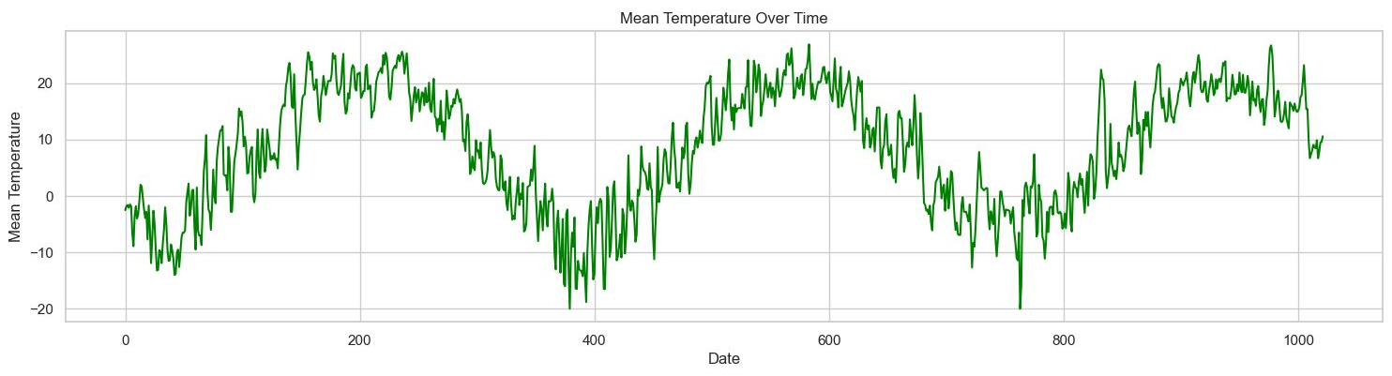
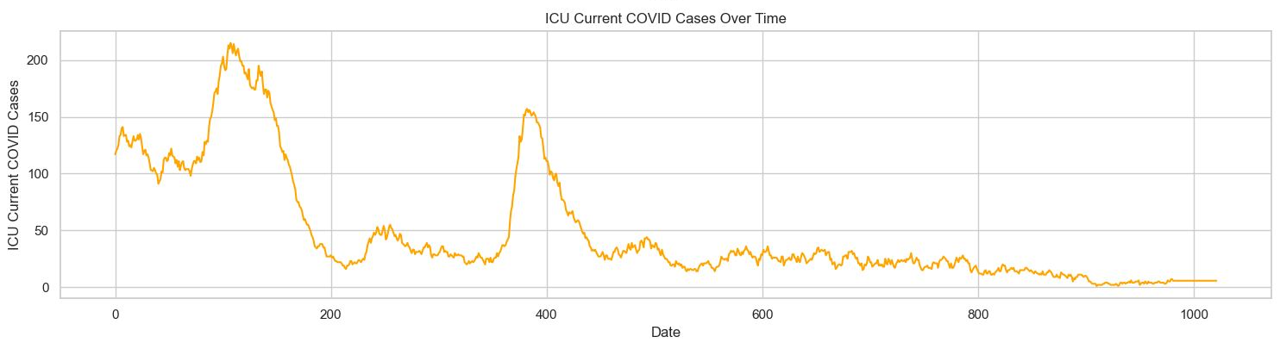
External Data
Task 1
Daily Average Temperature
Average Temperature Violent Crimes
Number of Covid Related ICU Patients
Covid Patients Break and Enter

Slide 8
Data Preprocessing
Task 1
Crime Data
Approximately assigning crimes to each district based on city
Aggregating data for each date
Keep only ‘date’, ‘district’ and ‘number of crimes’ features (columns)
Creating ‘month’, ‘week’, ‘year’ and ‘Ontario Holidays’ features
Monthly Unemployment Rate
Resampling data from monthly frequency to daily.
Forward-filling missing values

Slide 9
DATA PREPROCESSING
Task 1
Daily Precipitation / Snow on Ground / Average Temperature
Replacing missing values (NaN) with average of closest not NaN values
Number of Covid Related ICU Patients
Filtering all regions except York
Forward-filling missing values
Merge all datasets on each date

Slide 10
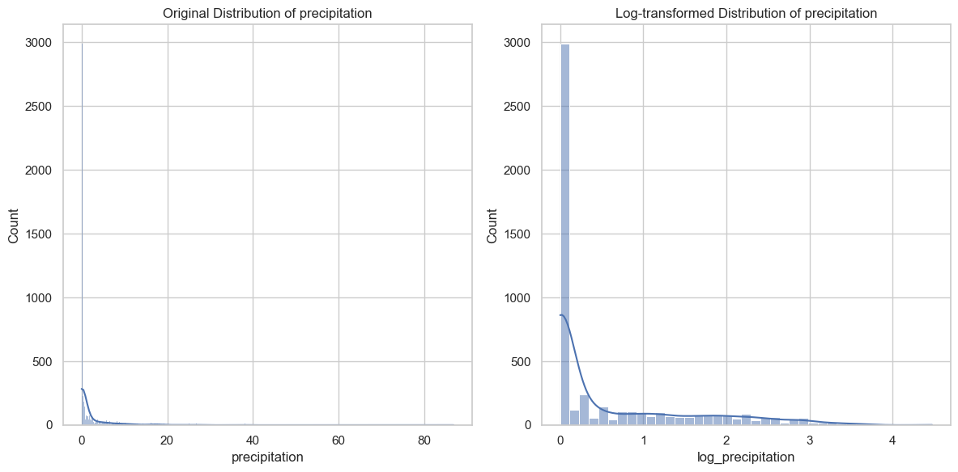
Feature engineering
Task 1
Moving Averages and Difference
Weighted moving averages of different features (not reasonable to predict on month based on one day)
Difference of features to see if that feature increasing or decreasing in last 30 days
Skewness Correction
Some models are sensitive to skewness of features.
Creating Periodic Time Features
Intuition: the first (day 1) and the last day (365) of a year should have similar encodings
Scaling Features Between 0 and 1

Slide 11
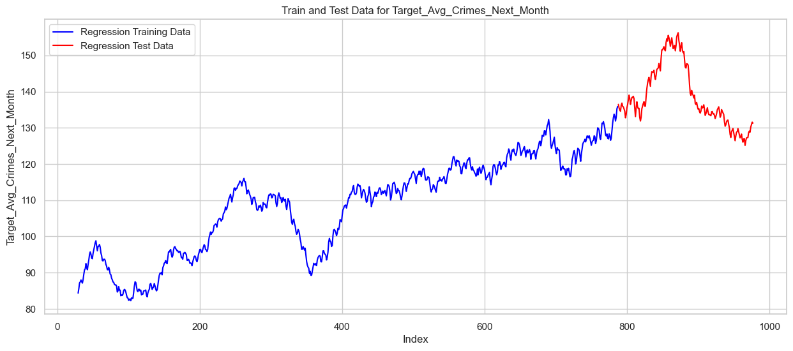
Training, validation and test data
Task 1
Training Data
The subset of data used to train the model.
Our Approach: 80% of the data is allocated for training.
Validation Data
A separate portion of the dataset used to tune model hyper-parameters without biasing the model.
Our Approach: Utilized within time-series cross-validation.
Test Data
Data that the model has not seen before, used for final evaluation.
Our Approach: 20% of the data is allocated for training.

Slide 12
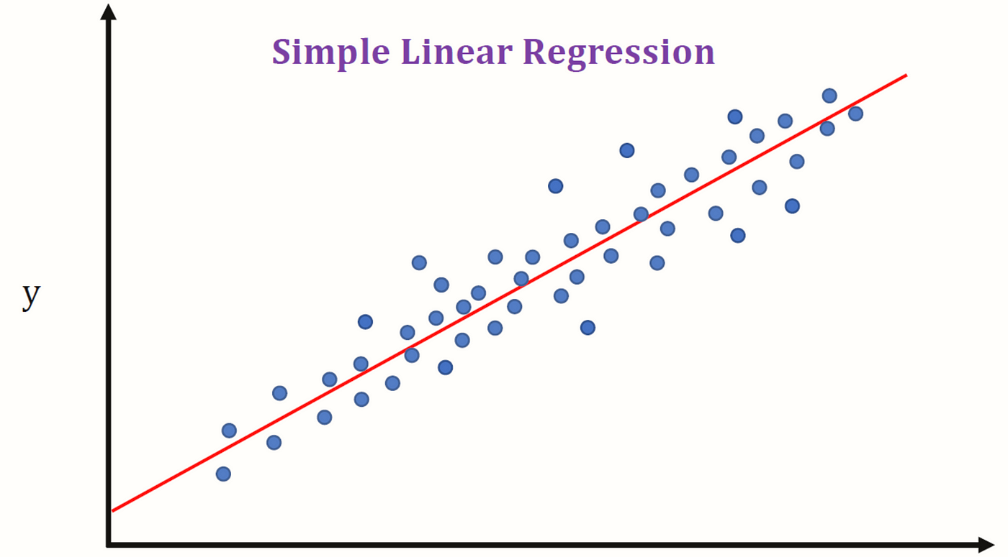
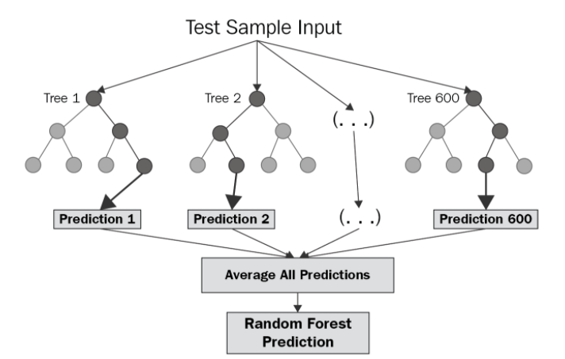
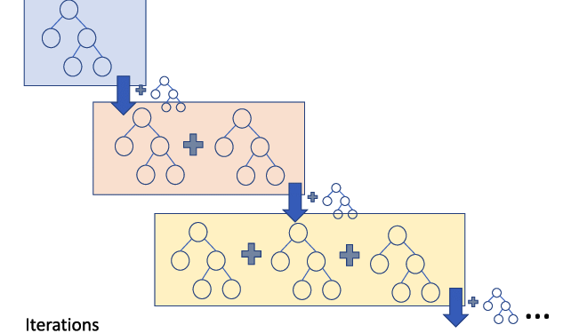
Overview of models
Task 1
Linear Regression
A statistical method for modeling the relationship between features and target value.
Assumes a linear relationship between variables.
Random Forest Regressor
Operates by constructing multiple decision trees during training and outputting the mean prediction of the individual trees.
Gradient Boosting Regressor
A machine learning technique that builds models from an ensemble of weak prediction models, typically decision trees.

Slide 13
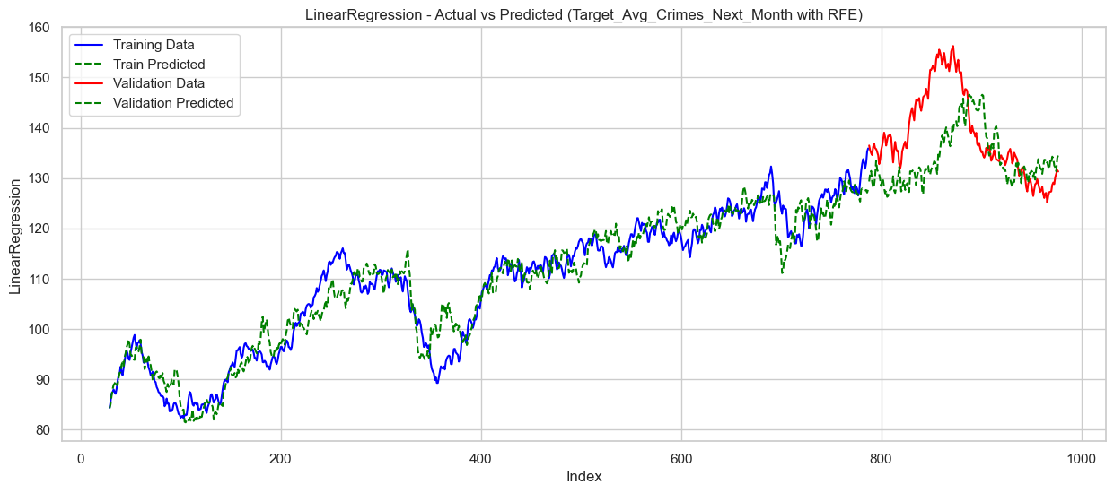
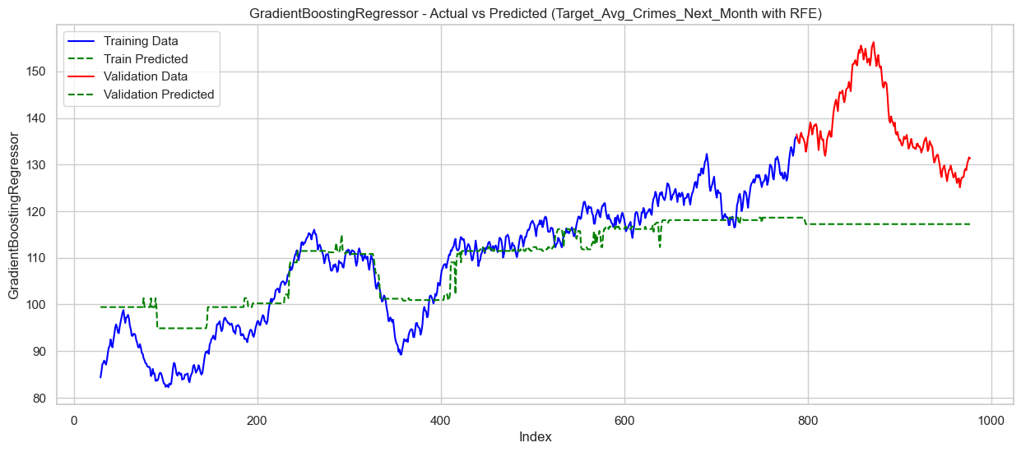
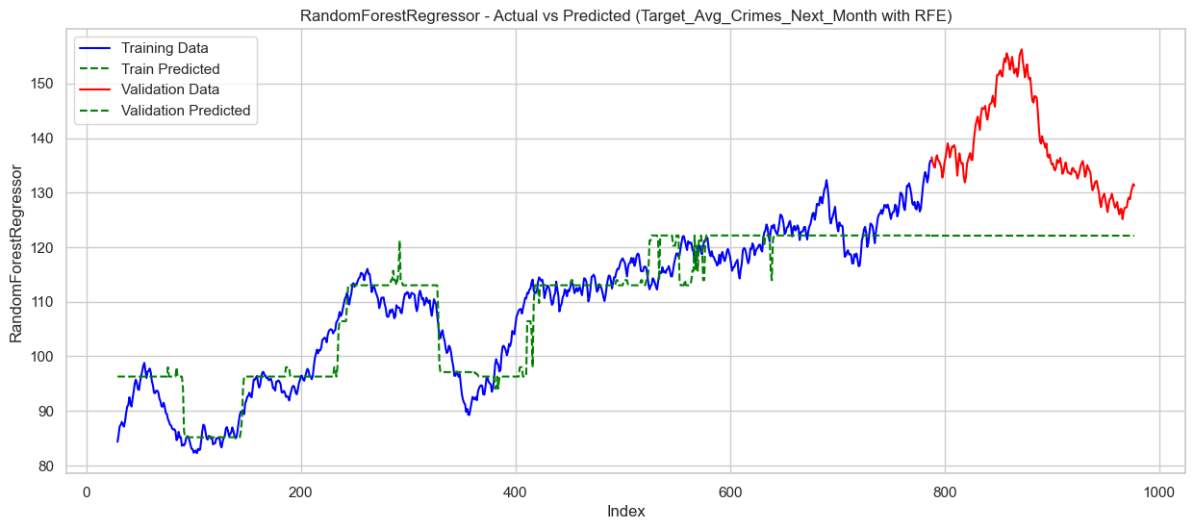
Basic Models performance
Task 1
Tree-based models does not give decent results
Cannot extrapolate beyond the value of training data
Mean Square Error on Test
Linear : 91.01, Forest : 338.73, Boosting : 521.73
Best model: Linear Regression

Slide 14
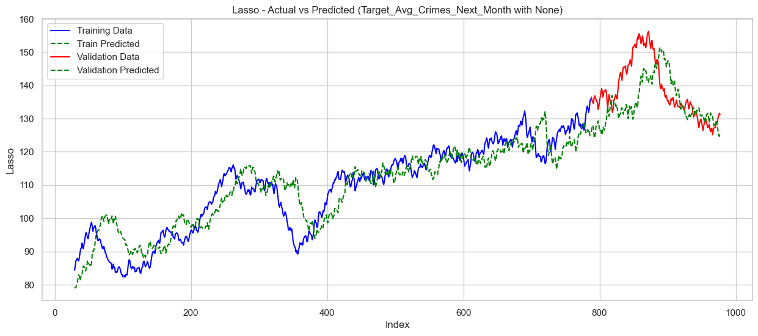
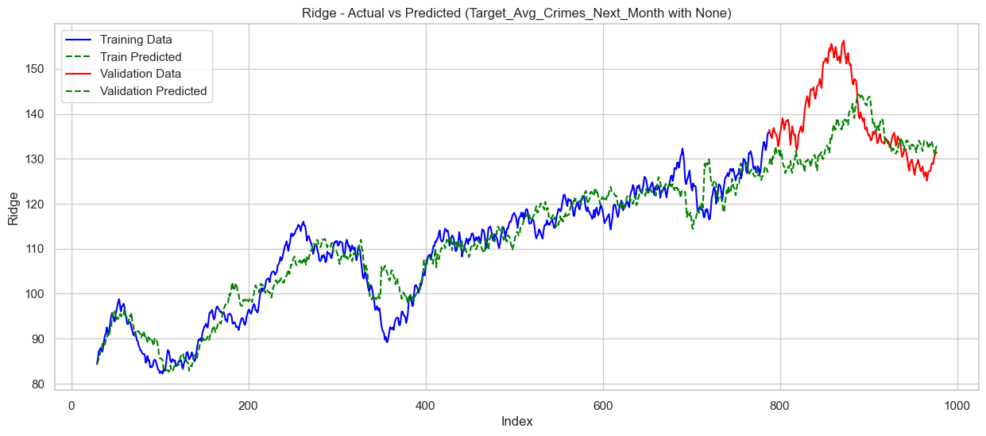
Linear Models Performance
Task 1
Ridge and Lasso
Sacrifice train error for test error on linear regression
Mean Square Error on Test
Linear : 91.01, Ridge : 96.23, Lasso : 78.81
Best model: Lasso Regression

Slide 15
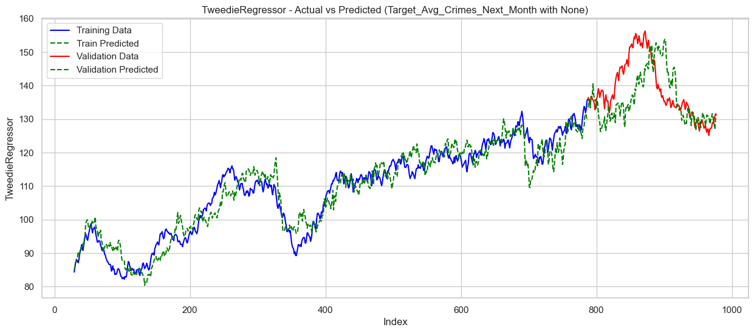
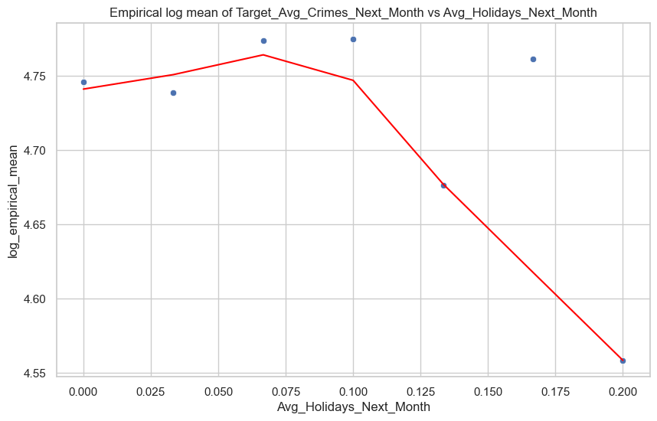
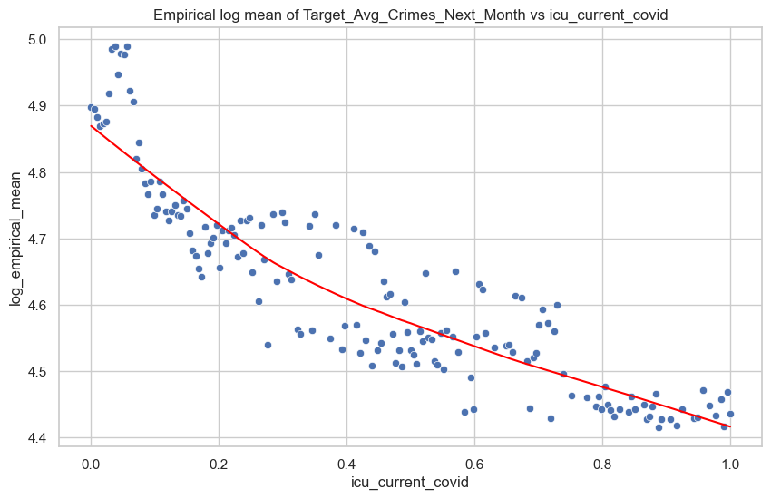
Poisson Models Performance
Task 1
Poisson Regression
Suitable for count data
Mean Square Error on Test
Poisson : 74.99
Linear relation between log of target and features
Adding Squared Features for Linearization

Slide 16
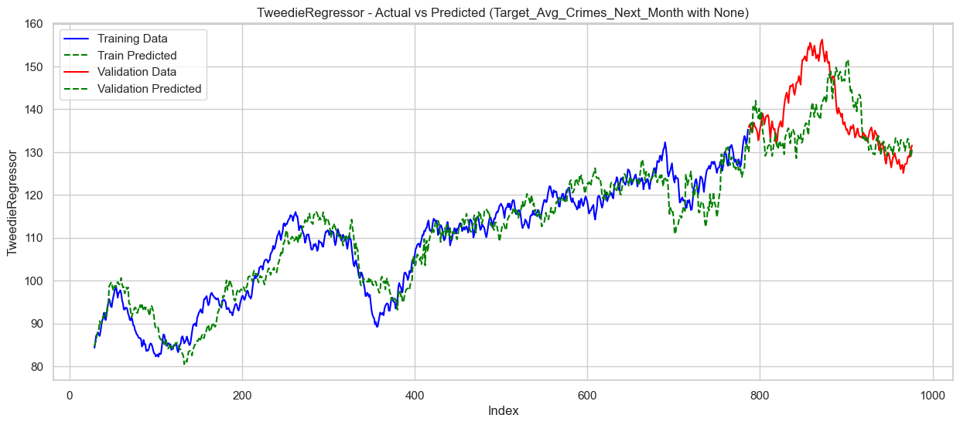
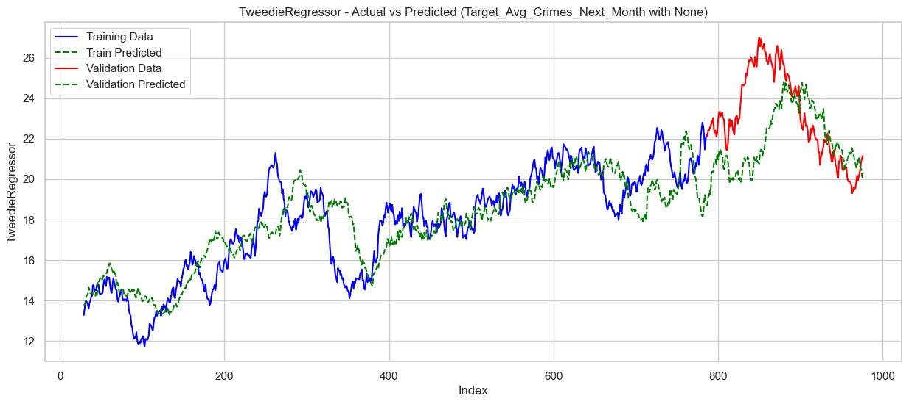
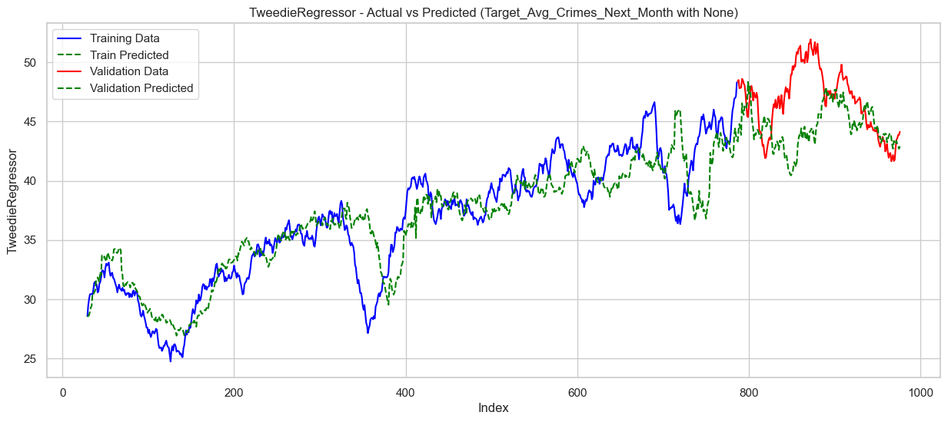
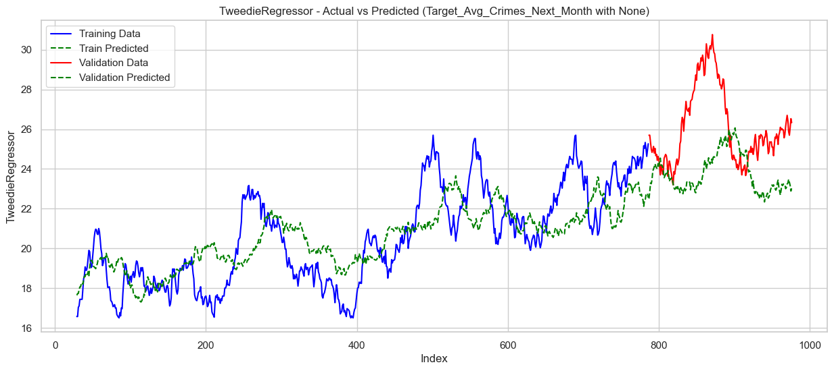
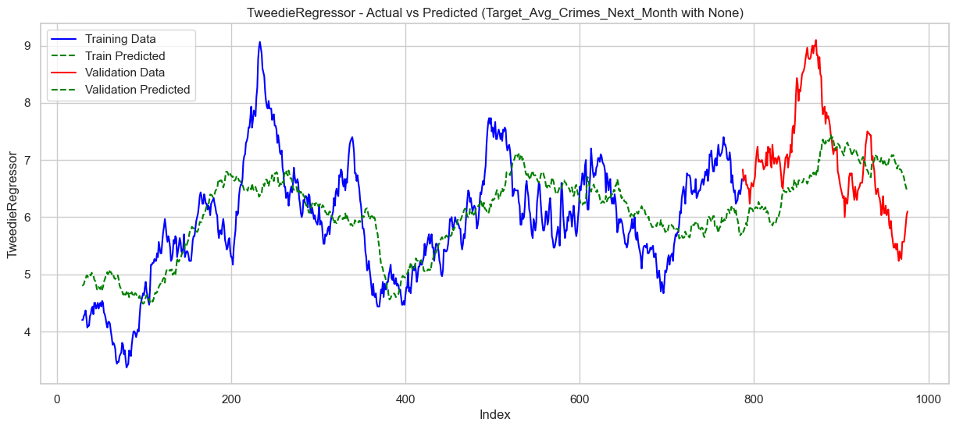
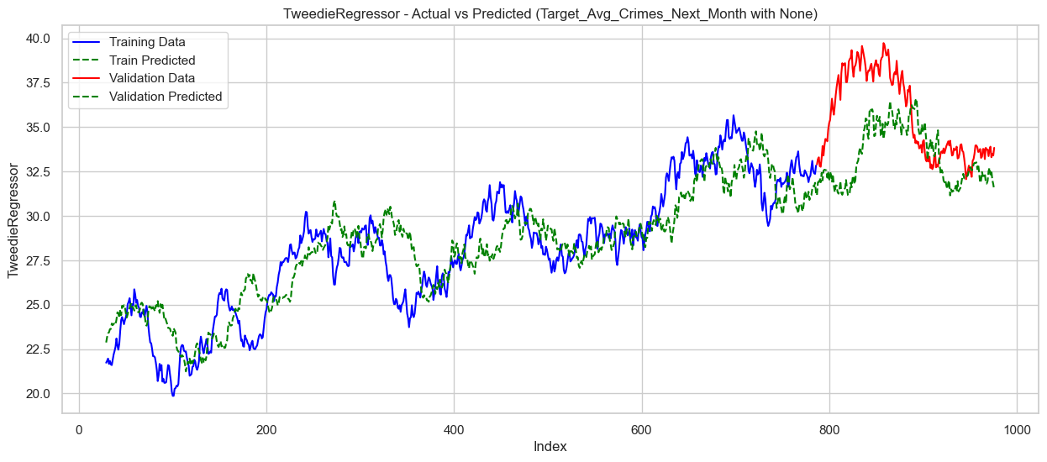
enhanced Poisson Models Performance
Task 1
York Region
District 2
District 4
District 1
District 3
District 5
Time

Slide 17
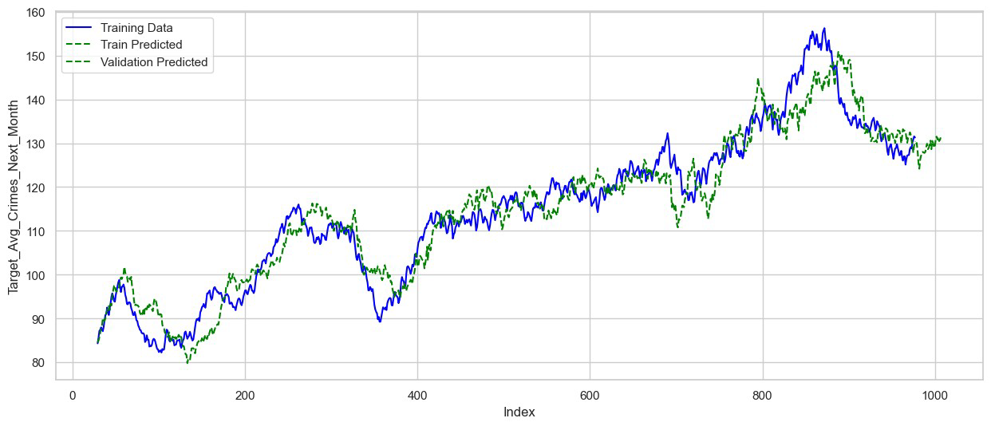
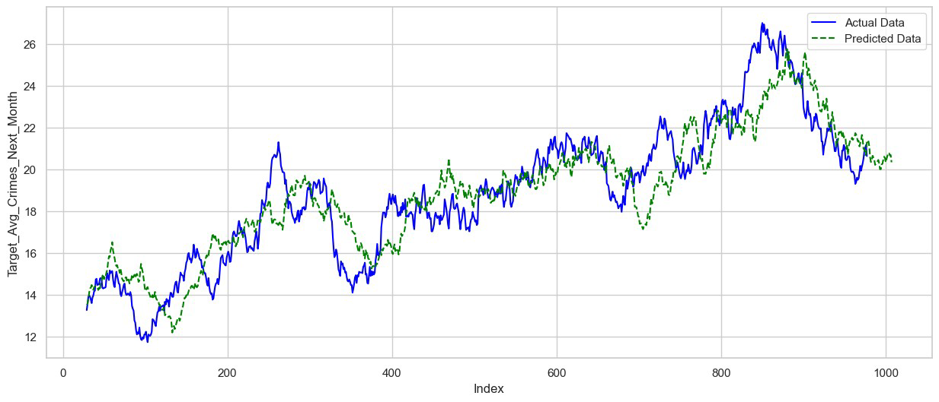
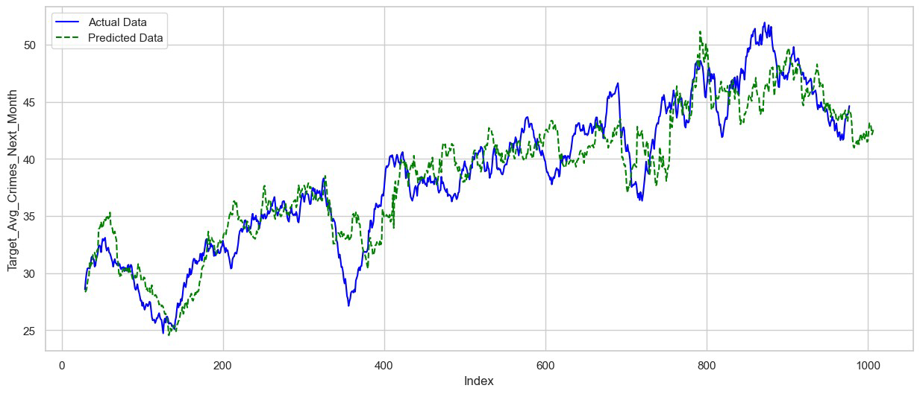
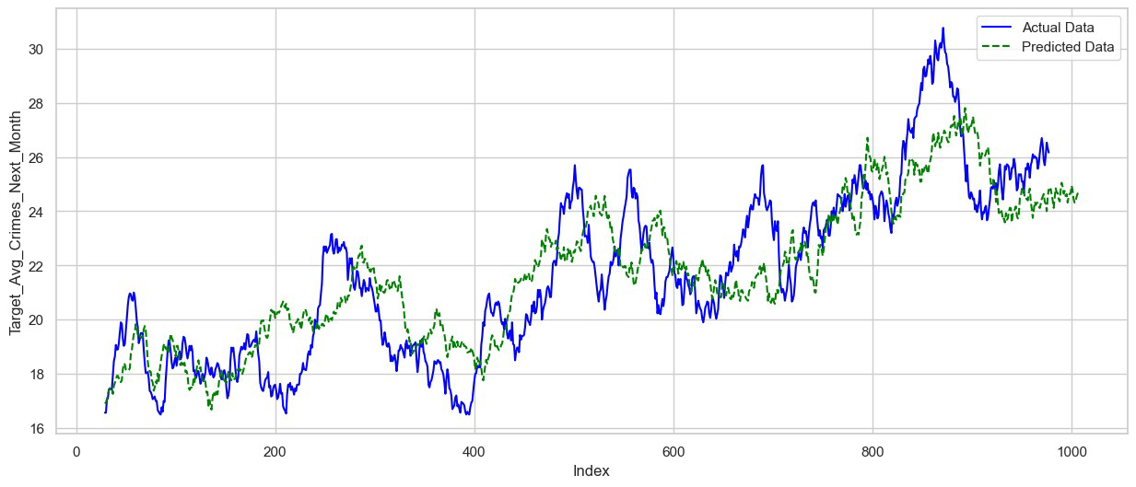
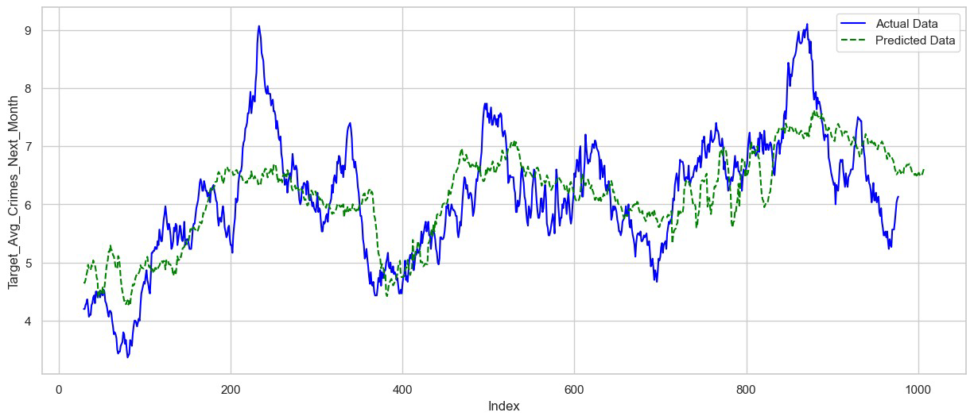
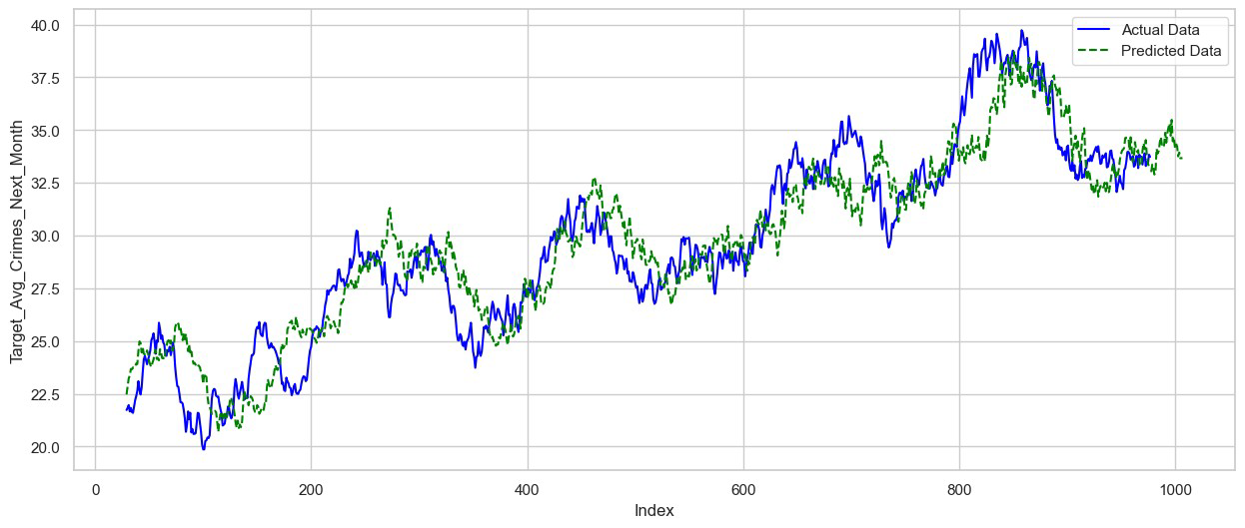
Future Forecast
Task 1
York Region
District 2
District 4
District 1
District 3
District 5
Time

Slide 18
Forecast interpretation
Task 1
Predicted From High to Low
District 3, District 1, District 5, District 4, District 2
Change Forecasted
For Following Month
Actual Change
Calculated 2 days ago
District 1
-0.41%
-2.61%
District 2
-4.56%
-6.07%
Actual From High to Low
District 3, District 5, District1, District 4, District 2
District 3
0.84%
26.73%
District 4
-2.98%
-3.41%
Caution: While the model predicts a decrease, it's important to maintain vigilance and not become complacent, as external factors not captured by the model could influence crime rates.
District 5
-1.05%
-0.27%
Note that there was an error in preprocessing X_forecast data which leaded to using last 14 days of the crime data and forecasting 30+14 days instead of 30 days in the report submitted initially. The problem has been addressed in the current draft.

Slide 19
Overview
Task 2
Objective
Forecast potential staffing challenges in York Region’s 4th District.
Approach
Analyze exception codes, service call demands, and crime history datasets.
Utilize data visualization to identify patterns influencing staffing needs.
Significance
Facilitate strategic personnel scheduling and resource optimization.
Enhance the effectiveness of law enforcement responses and community safety.

Slide 20
Data
Task 2
4 District Platoon Staffing Exceptions
Containing every exceptions between 2020-2022 together with Date, length and type
Calls for Service
Containing every exceptions between 2020-2022 together with Date, District and type
Keep only District 4
Crime History
Merge daily number of each occurrence in the final dataset

Slide 21
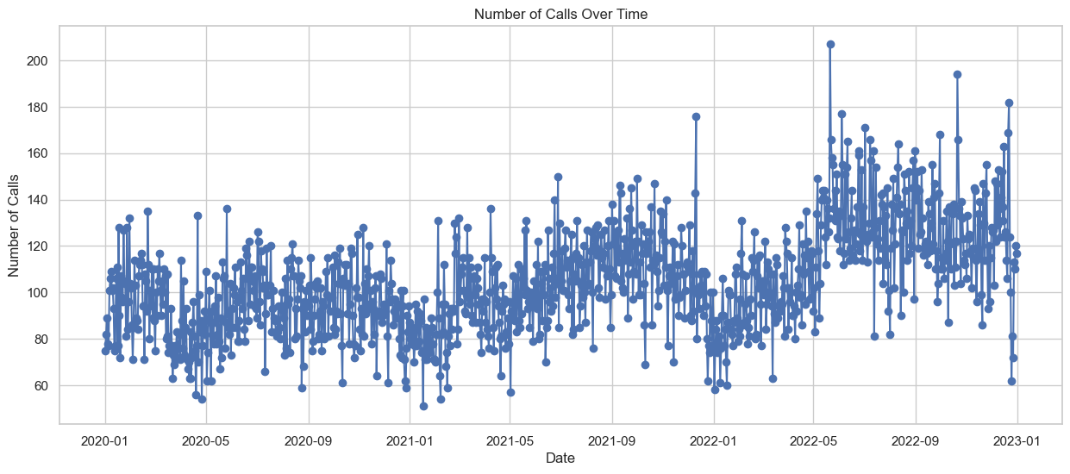
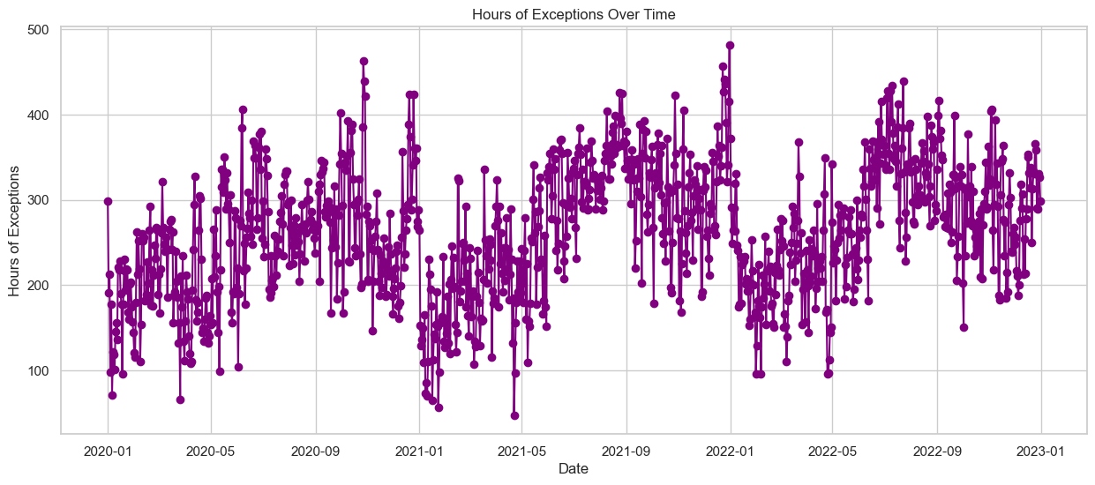
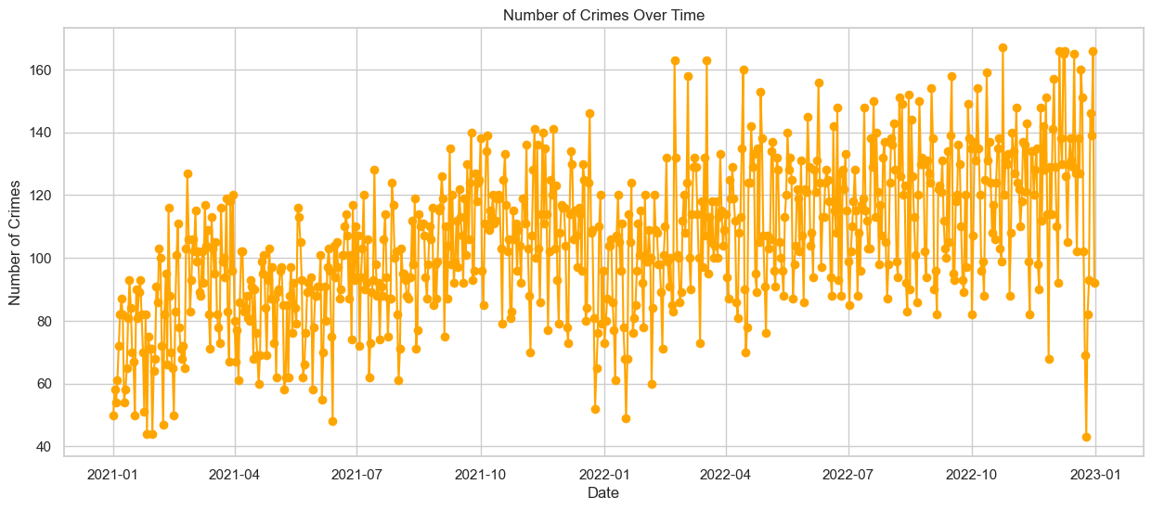
Raw data visualization
Task 2
Obvious seasonality and trends in data but hard to interpret
Let’s aggregate data!

Slide 22
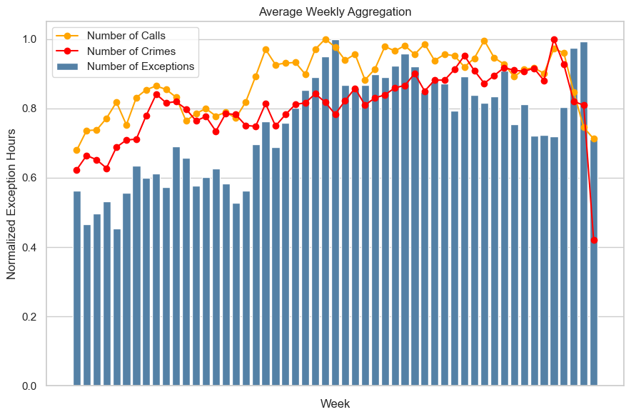
Weekly Aggregation
Task 2
Increase in Exceptions From Week 20 to Year-End
Possible Causes: Warmer weather in Canada
Increase in calls and crimes in same month
Suggests a potential need for increasing officer availability in these weeks

Slide 23
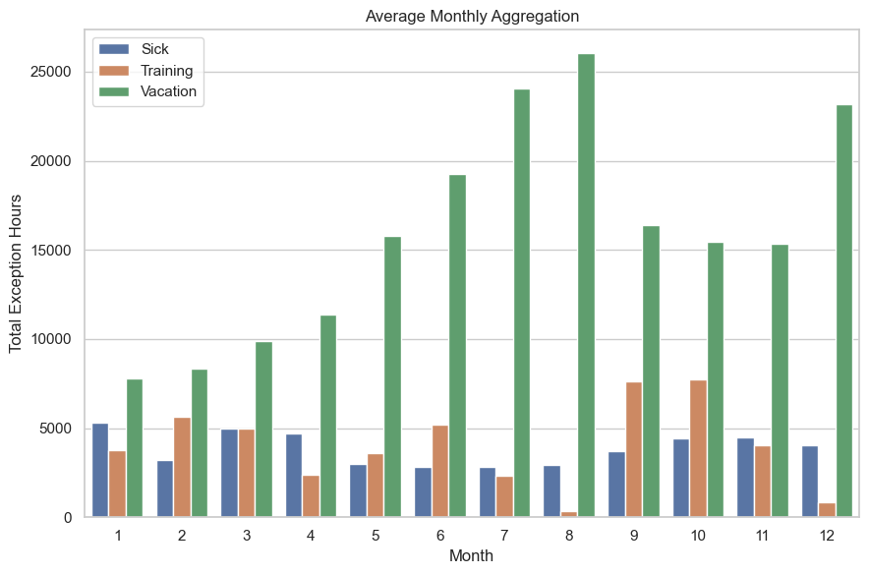
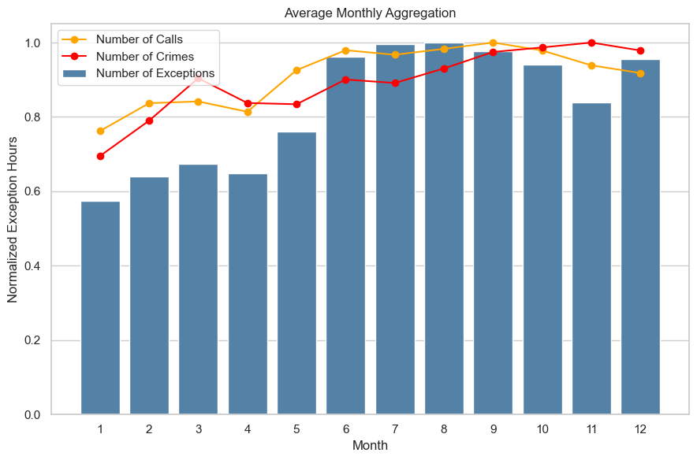
Monthly Aggregation
Task 2
Increase in Exceptions From June to Year-End
Possible Causes: Warmer weather in Canada and increase in training exceptions in Sep and Oct
Increase in calls and crimes in same month
Suggests a potential need for increasing officer availability or delay training sections to start of the next year

Slide 24
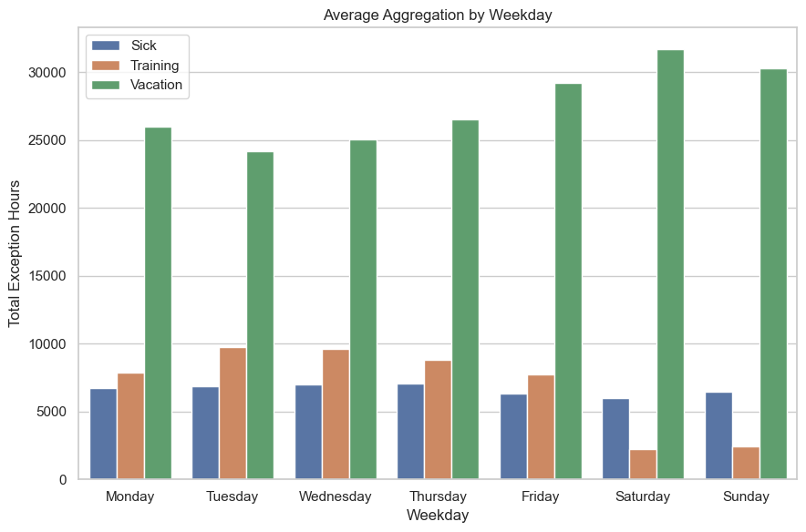
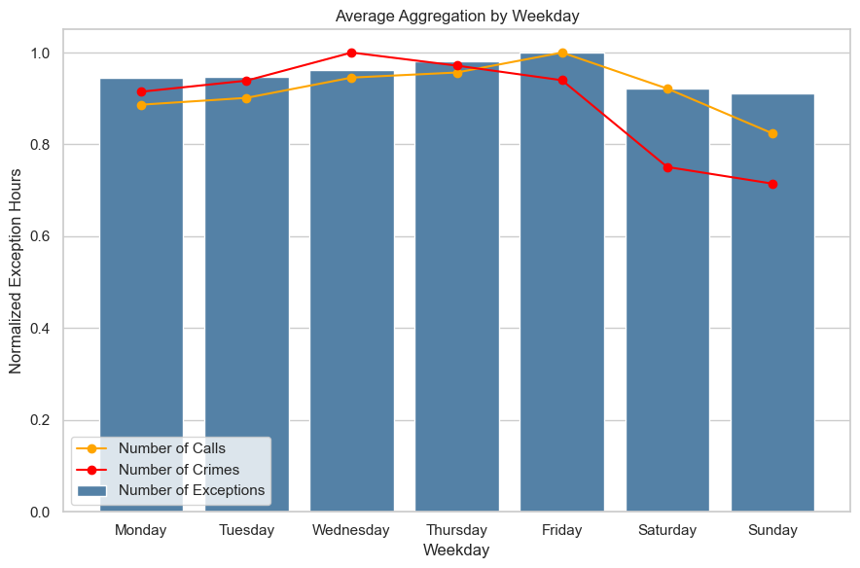
weekday Aggregation
Task 2
Increase in Exceptions on Friday
Possible Causes: More vacation exceptions
Increase in calls and crimes on the same day
Suggests a potential need for increasing officer availability or reschedule training sections to weekends (if possible)

Slide 25
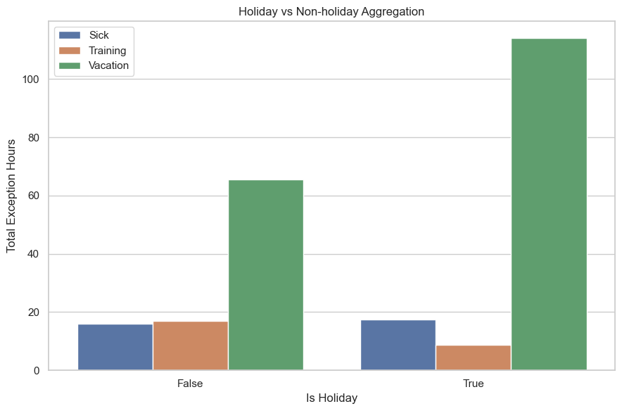
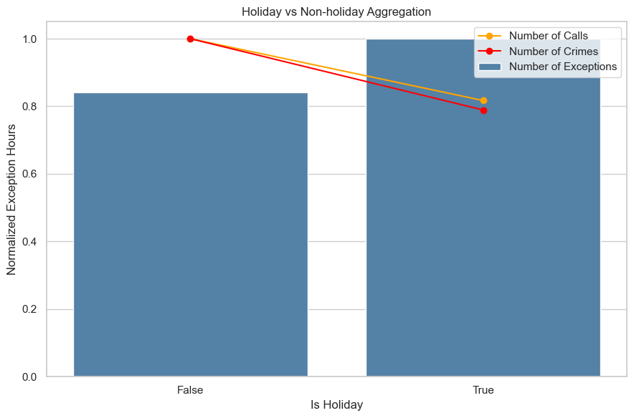
Holiday Aggregation
Task 2
Increase in Exceptions on Holidays
Possible Causes: More vacation exceptions
Decrease in calls and crimes on the same days

Slide 26
Recommended policy implications
Task 2
Changing dates
June to August and December (Vacation)
September and October (Training)
Fridays (Vacation)
Recommendations
Rescheduling training sections or increase officer availability

Slide 27
Future work
Future Work
Task 1
Using crime data happened before 2021
More External Factors: Airbnb, LCBO sale, News (violence in middle east)
Weighed Mean Square Error (to emphasize on resent dates)
Different feature engineering methods for Random Forest and Gradient Boosting
Task 2
Using the number of officer on work to consider effect of offs on days with less officer

Slide 28
THANK YOU!

